Slide 1
Data Augmentation For Wav2Vec2
Russell Wang, Eason Wang

Slide 2
Agenda
Motivations
Methods
Model Training
Evaluation
Discussion

Slide 3
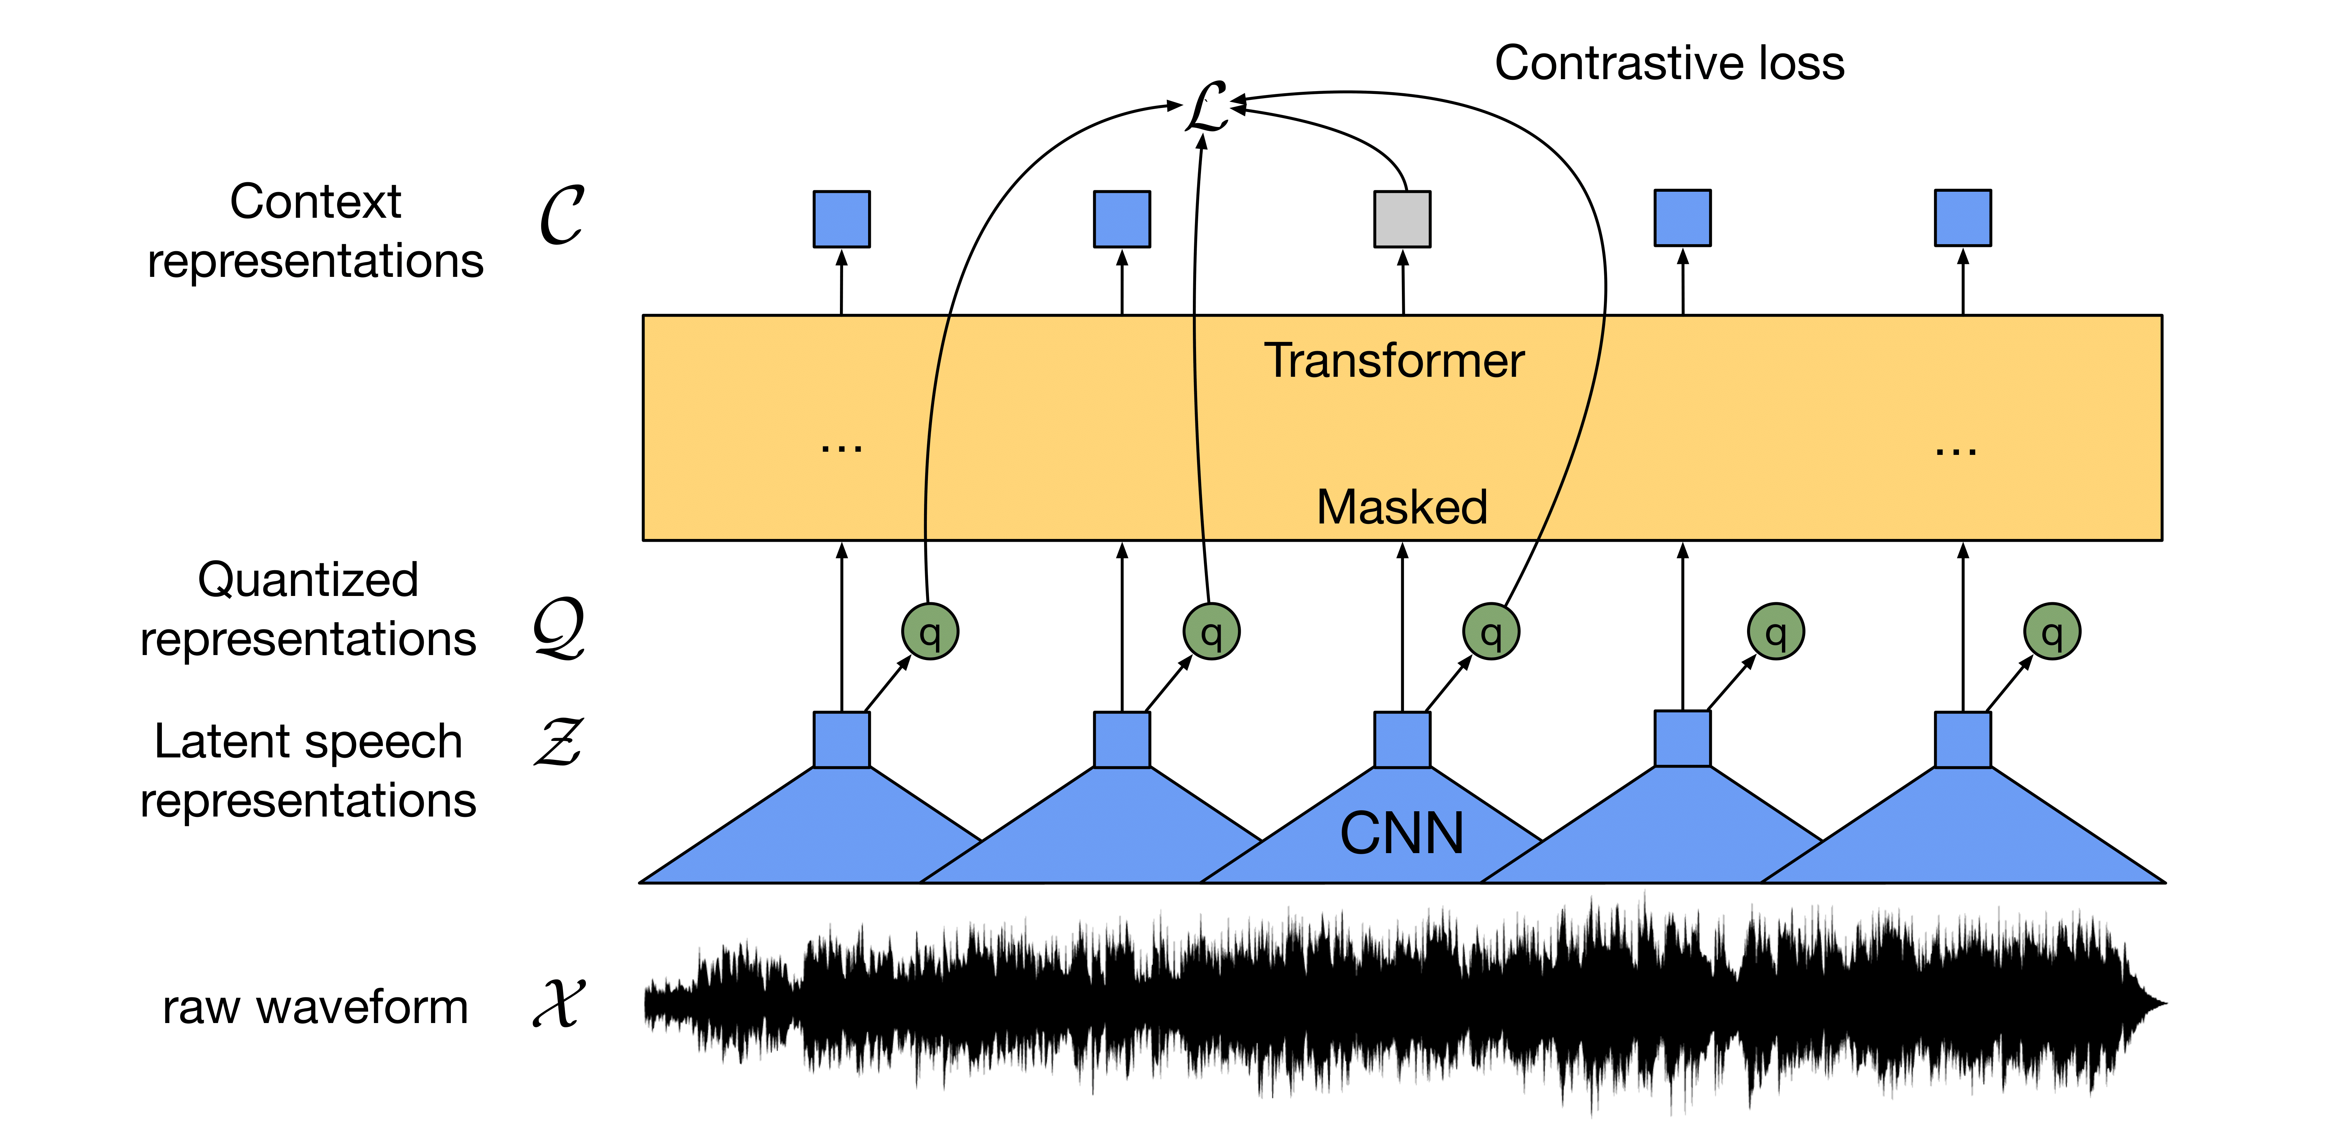
Introduction
Wav2Vec2, state-of-the-art speech recognition
Trained on labeled data(10 mins) + unlabeled data(53k hours)
4.8/8.2 WER on Librispeech test data.
https://arxiv.org/pdf/2006.11477.pdf

Slide 4
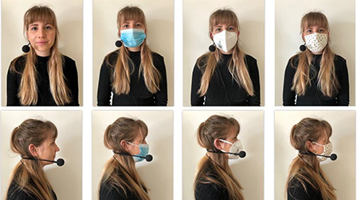
Project Goal
Further Improvement in the low data regime – Data Augmentation
Standard: Speed, Noise, Pitch
“Speech under Mask” Simulation
https://asa.scitation.org/doi/10.1121/10.0002873

Slide 5

Standard Augmentation
Random Speed Adjustment - Factor Range(0.75, 1.25)
Random Pitch Adjustment - Factor Range(-3, 3), semitone as one unit
Small Random Noise – Factor Range(0.0001, 0.0003)
Original
Augmented

Slide 6
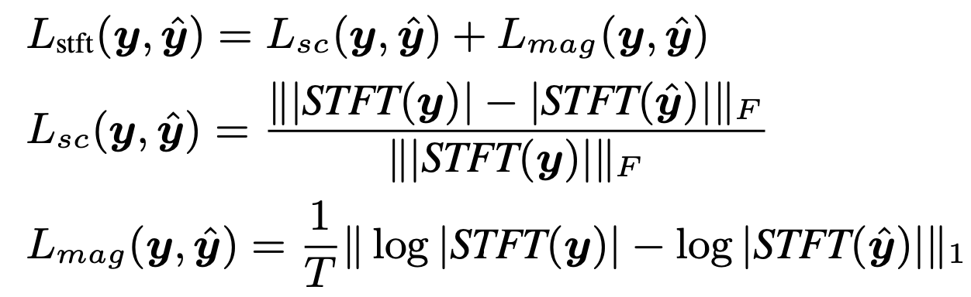
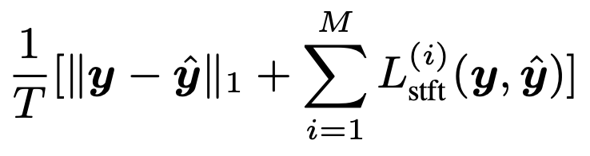
Speech Under Mask
Objective: Transform speech without mask to speech with mask
Methodology: Speech Denoiser Network DEMUCS
Similar task setup: noisy speech -> denoised speech
Encoder-decoder architecture
L1 loss over the waveform + STFT loss over the spectrogram magnitudes
https://arxiv.org/pdf/2006.12847.pdf

Slide 7
Speech Under Mask - Data
2 female + 2 male –> 1432 pairs of audio recordings
Resample to 16khz
Speech Alignment
Extract MFCCs and perform Dynamic Time Warping (DTW)
Align longer to shorter
Notes:
some background noise due to data scarcity and quality

Slide 8
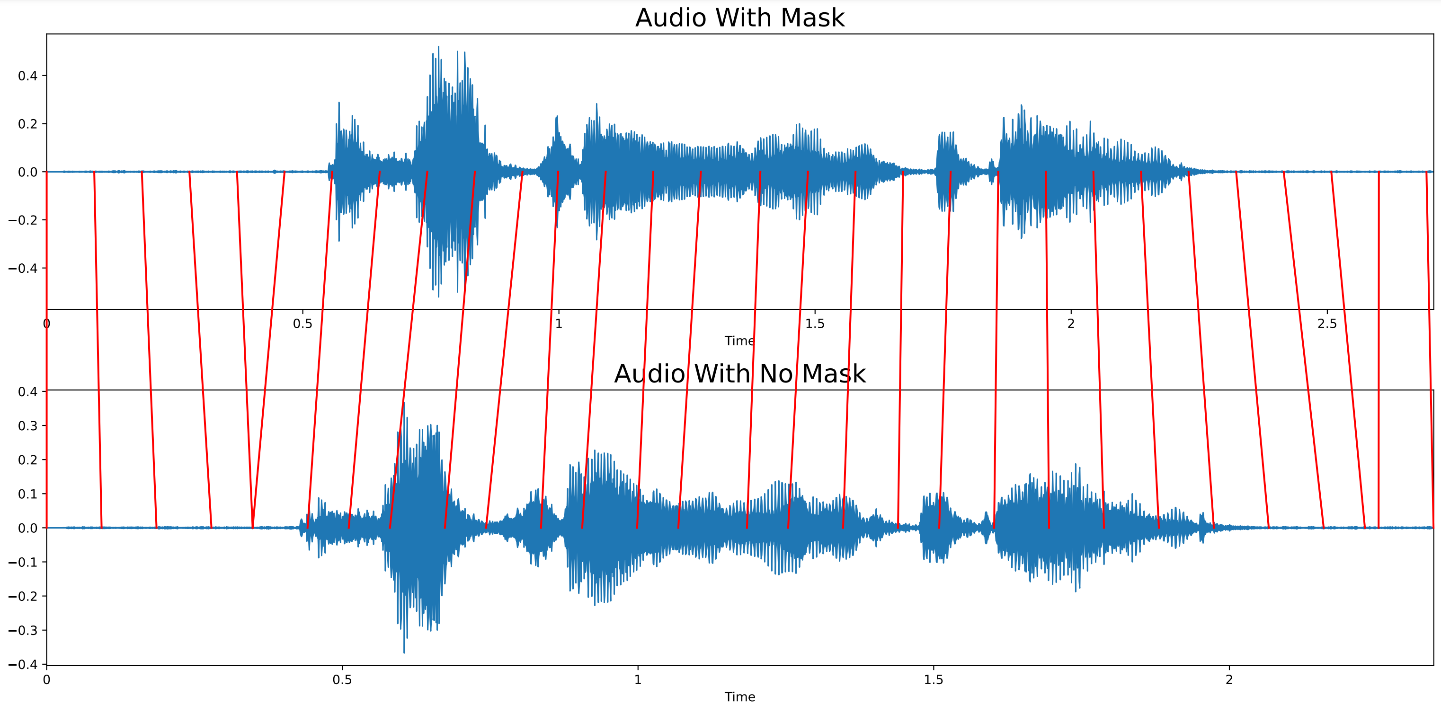
Speech Under Mask – Speech Alignment
Notes:
some background noise due to data scarcity and quality

Slide 9
Speech Under Mask – Result
Original
Generated
Notes:
some background noise due to data scarcity and quality

Slide 10
Model Training - Baseline
Dataset:
Training: Libri-Light 10min labeled data
Test: Libri-Light 9h labeled data
Training Process:
Base Wav2Vec2 Model
Pretrain on Librispeech (LS-960)
Fine-tune on Libri-Light 10min labeled data
https://arxiv.org/pdf/1912.07875.pdf

Slide 11
Model Training - Our Approach
Dataset:
Training: Libri-Light 10min labeled data
Test: Libri-Light 9h labeled data
Training Process:
Base Wav2Vec2 Model
Pretrain on Librispeech (LS-960)
Fine-tune on:
Original + Masked Speech (20min)
Original + Standard Augmentation (20min)
Original + Masked Speech + Standard Augmentation (30min)

Slide 12
Evaluation
Data Aug Type | Word Error Rate
Baseline: Original (10mins) | 8.641
Original + Masked Speech (20mins) | 8.493
Original + Standard Augmentation (20mins) | 8.277
Original + Masked Speech + Standard Augmentation (30mins) | 8.692

Slide 13
Conclusion
Data augmentation in speech does help improve the performance
Masked speech augmentation gives marginal improvement
Better and larger dataset will be helpful
Try style transfer
Can be used as a new way of data augmentation in speech

Slide 14

Future Work
Style Transfer for speech under mask simulation
Self-supervised Learning on Wav2Vec2, learn audio-level contrastive loss on data augmentations
Notes:
Due to time constraint, haven’t got this far

Slide 15
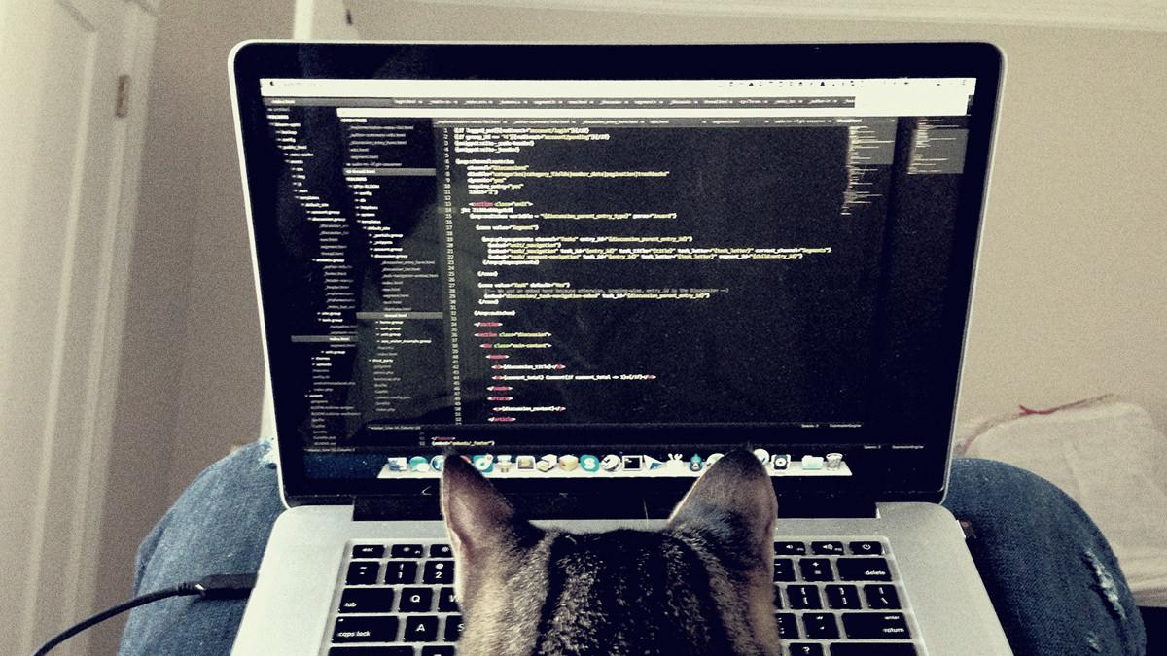
Q&A Time
BTW : Have a nice winter break :)

